Slide 1
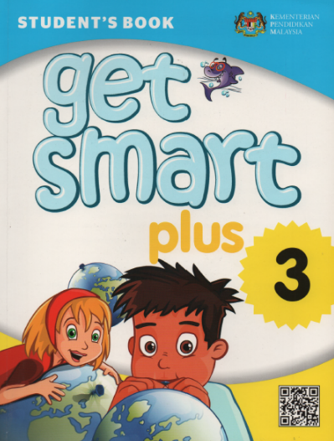
MODULE 1 welcome!
Get Smart Plus 3
WHAT’S THE TIME?
TEXTBOOK PAGE 10
By: PuanDiyana Azmin

Slide 2
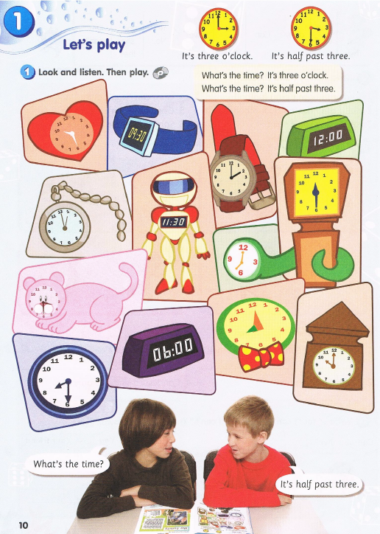
Textbook page 10
o’clock
a quarter past
half past

Slide 3
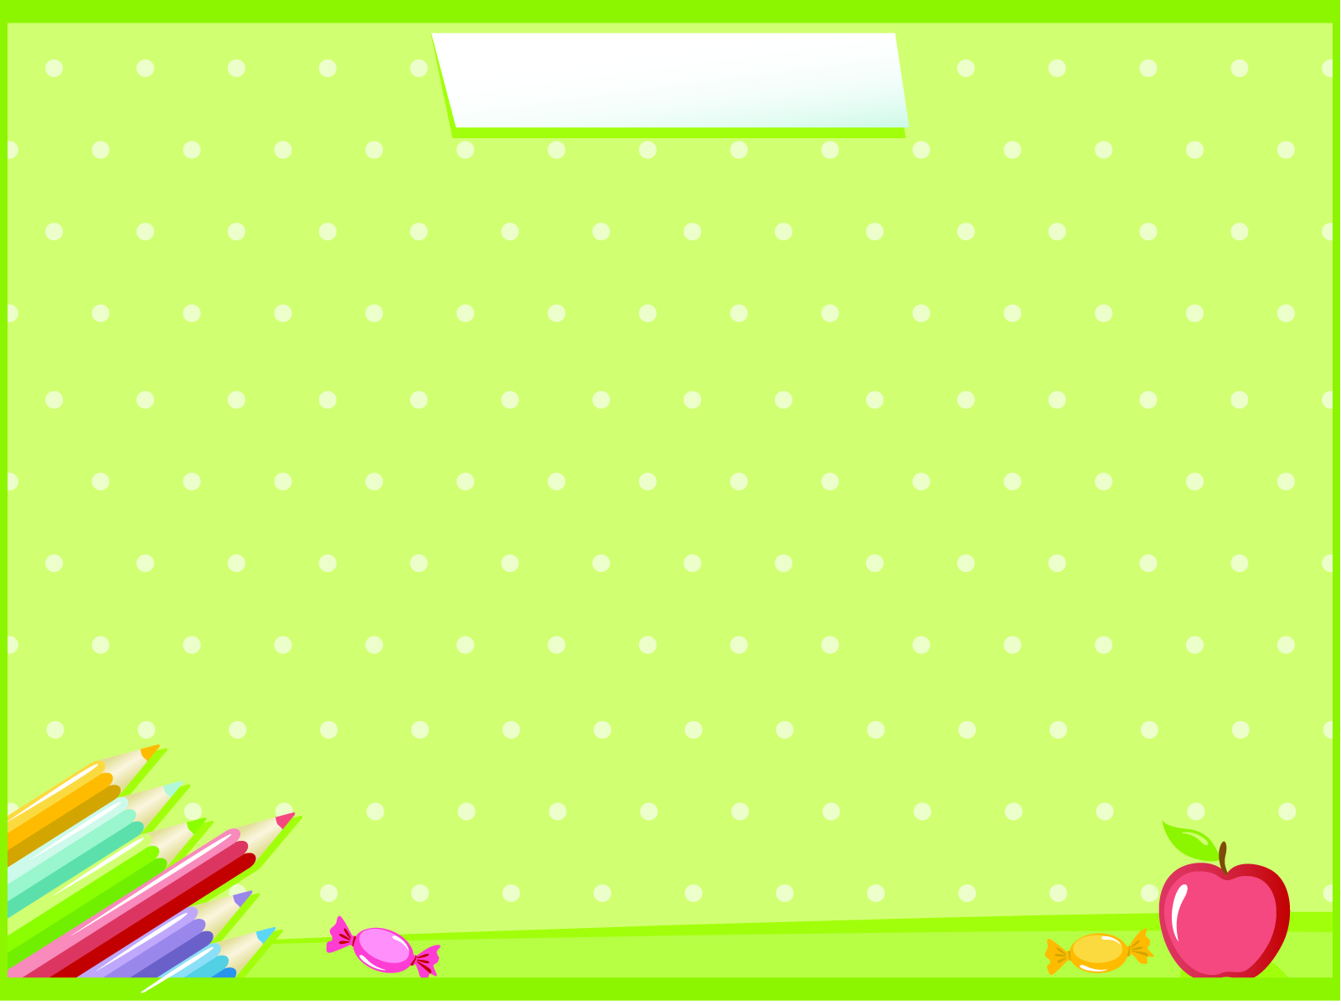
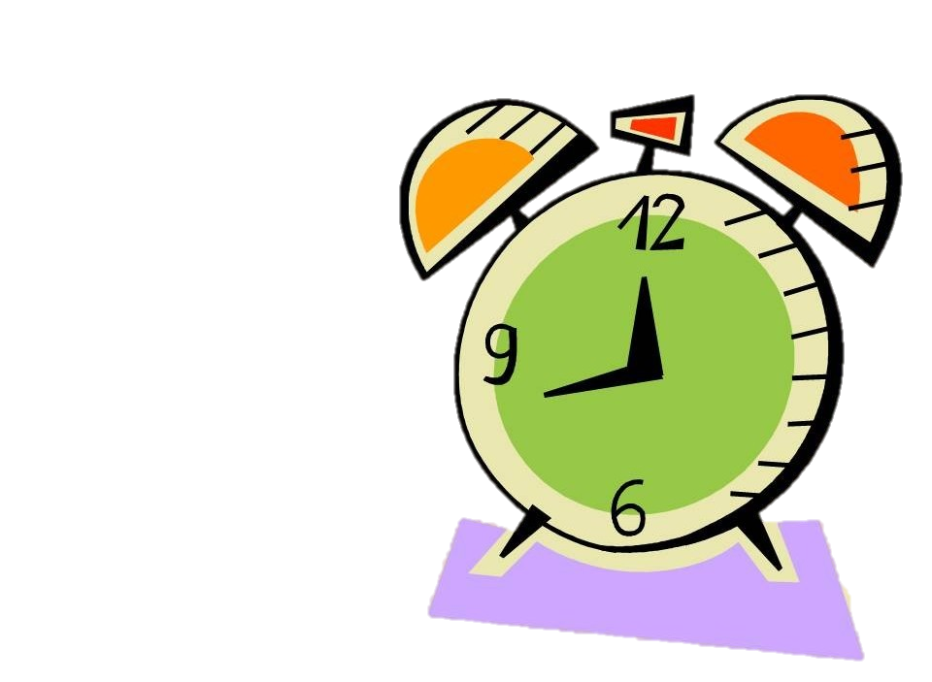
What’s the Time?

Slide 4
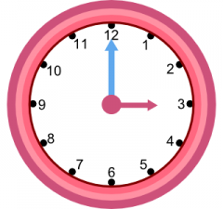
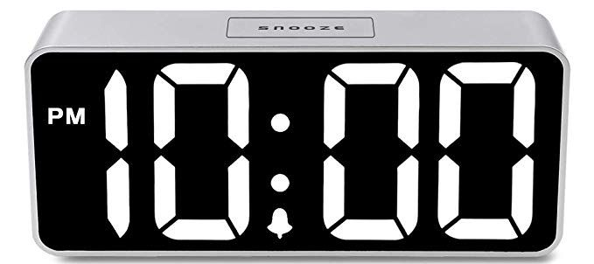
Analogue
Digital

Slide 5
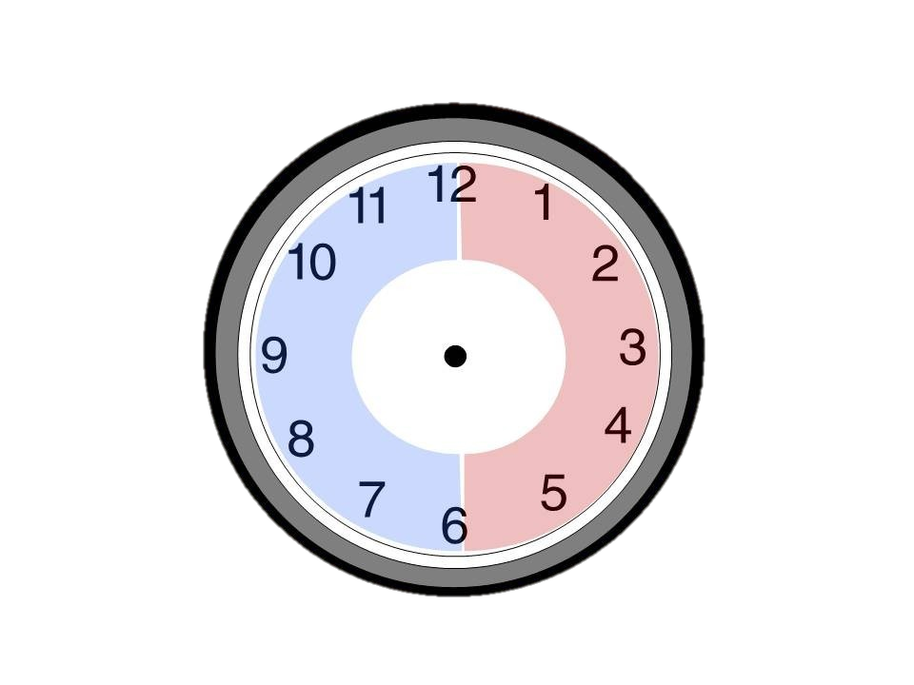
Analogue

Slide 6
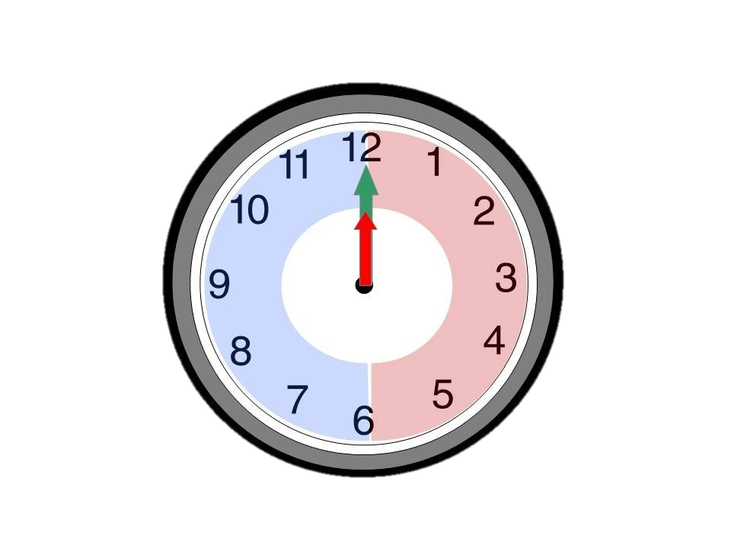
The clock has two hands.
The short hand is
the hour hand.
The long hand is the minute hand.

Slide 7
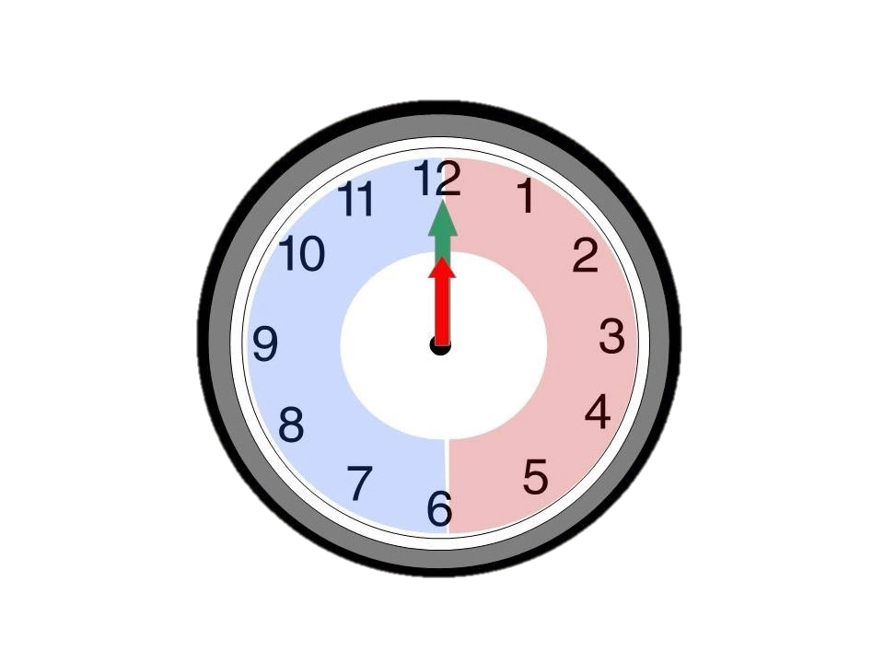
o’clock
twelve o’clock

Slide 8
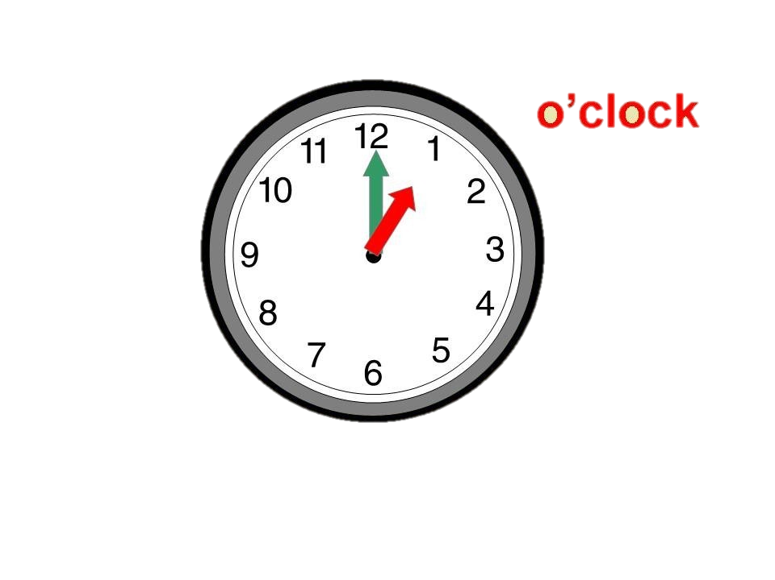

Slide 9
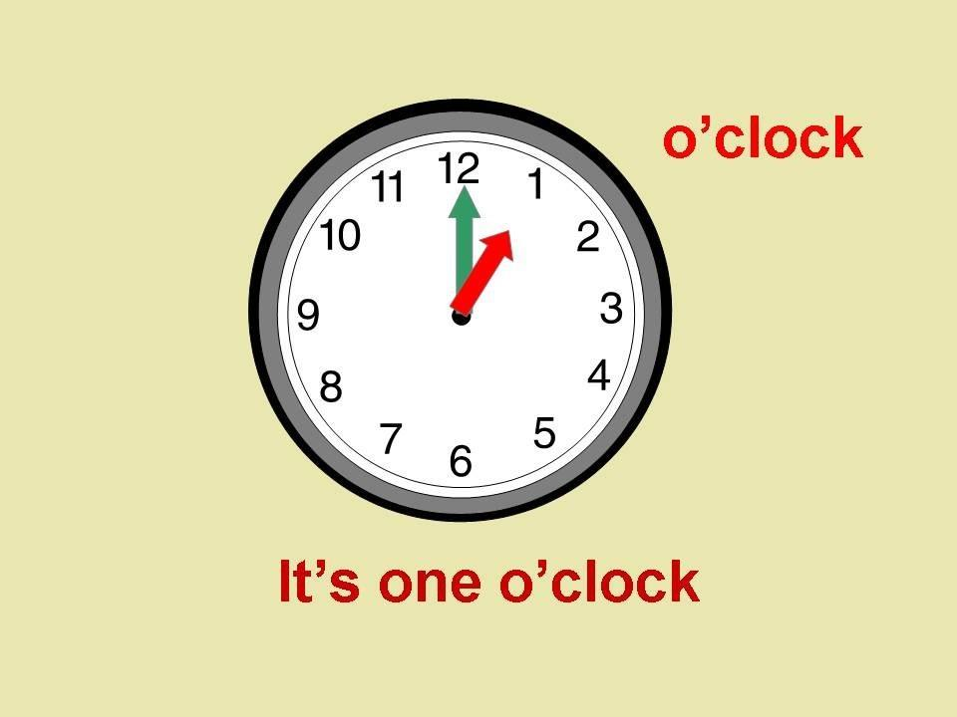

Slide 10
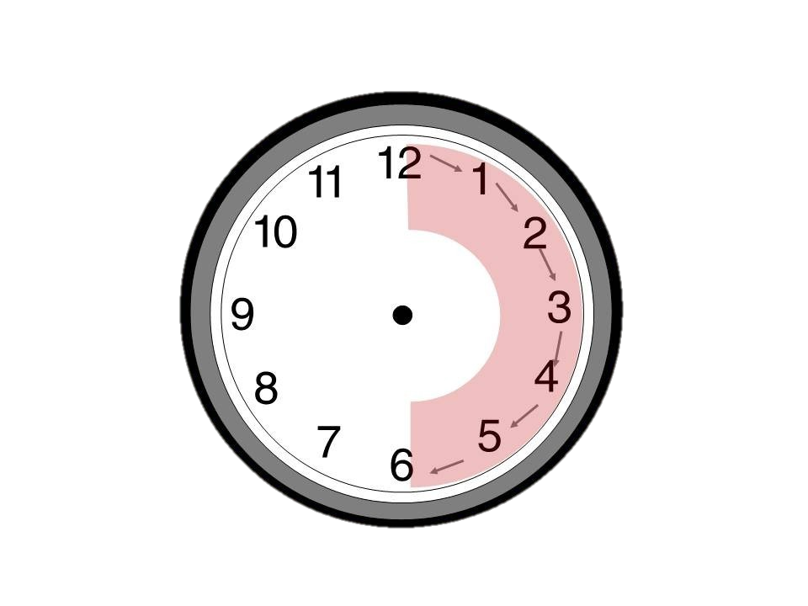
The directions of the
hands on the clock,
move to the right.
clockwise

Slide 11
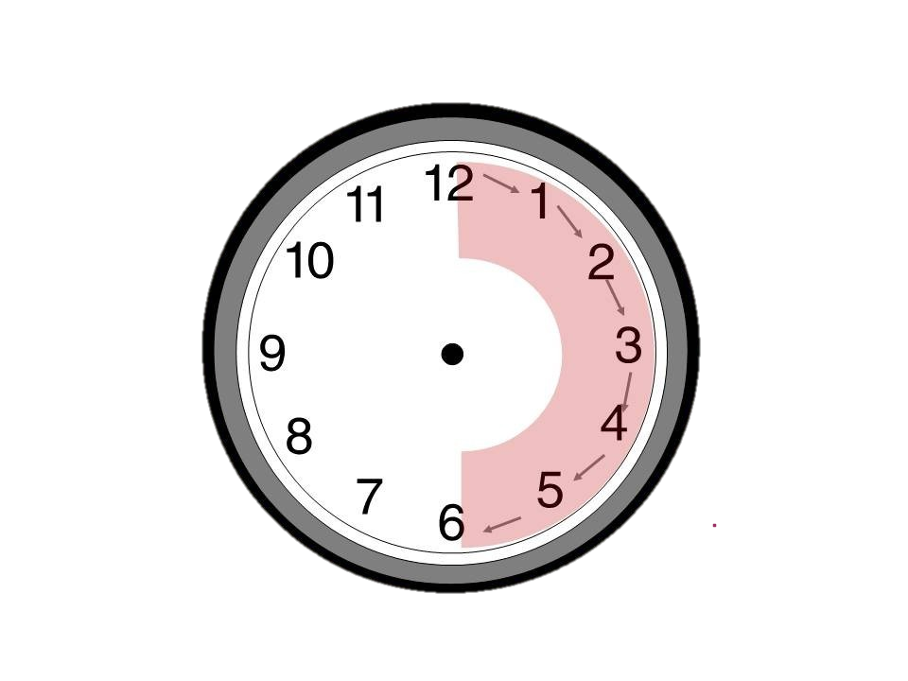
past
(past the hour)

Slide 12
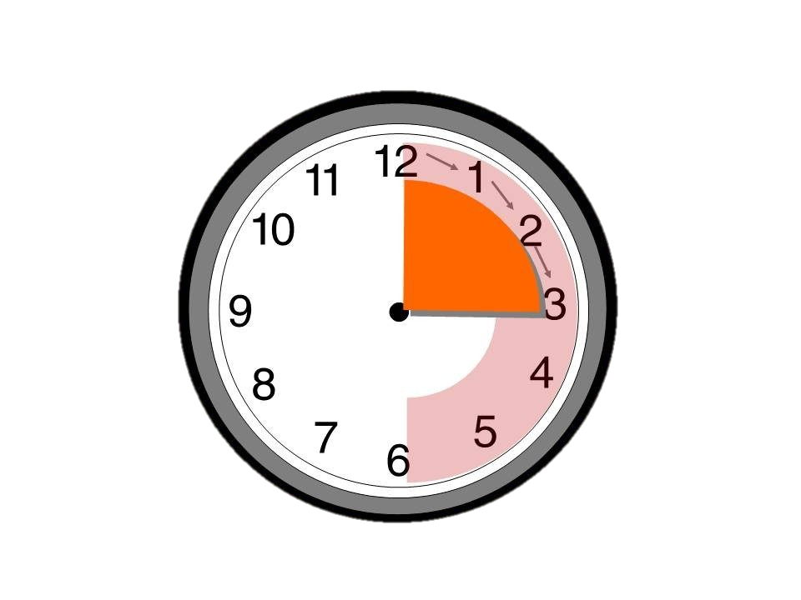
5
10
fifteen past…
15
quarter
a quarter past…

Slide 13
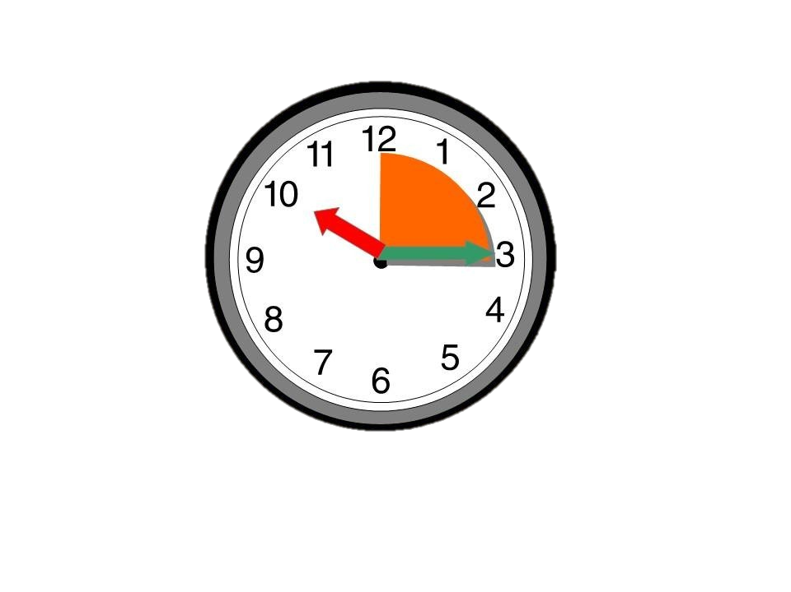
a quarter past
ten
It’s a quarter past ten.

Slide 14
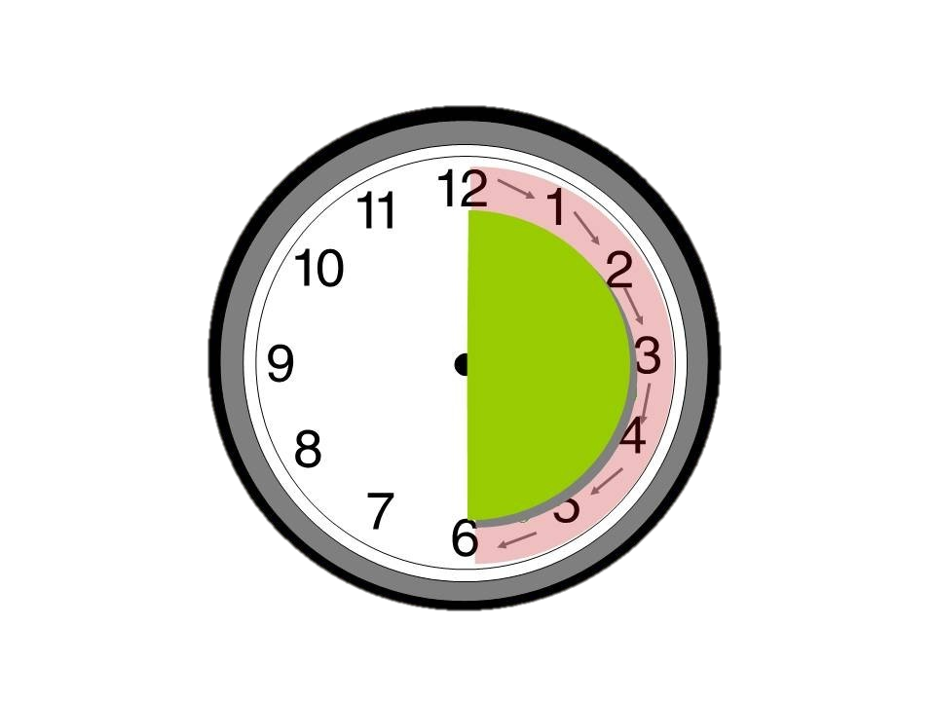
5
thirty past…
10
15
half
20
25
half past…
30

Slide 15
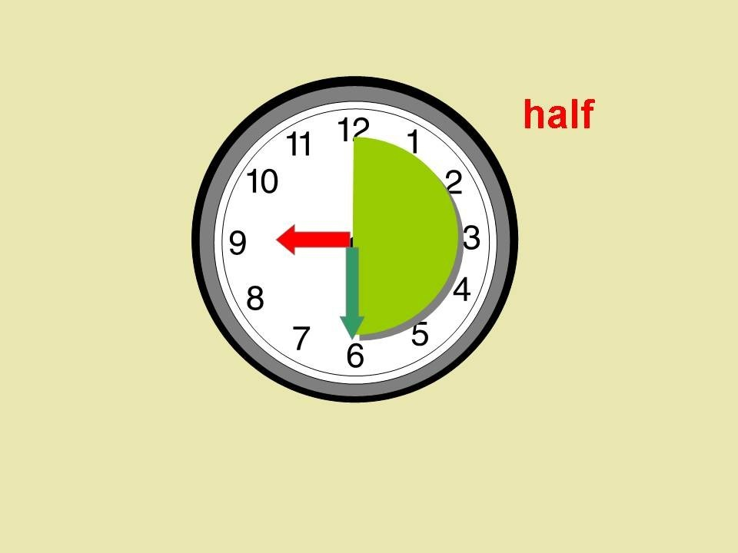
half past…
nine

Slide 16
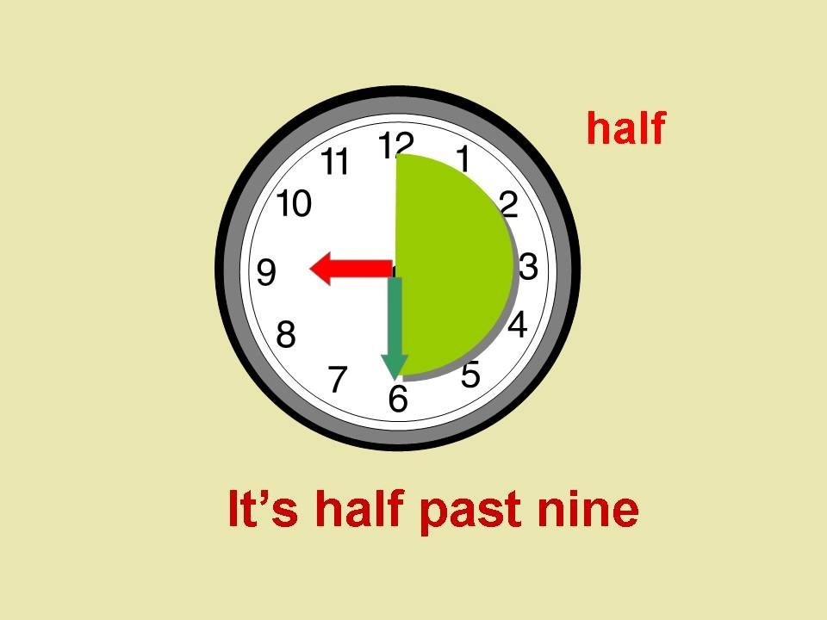

Slide 17
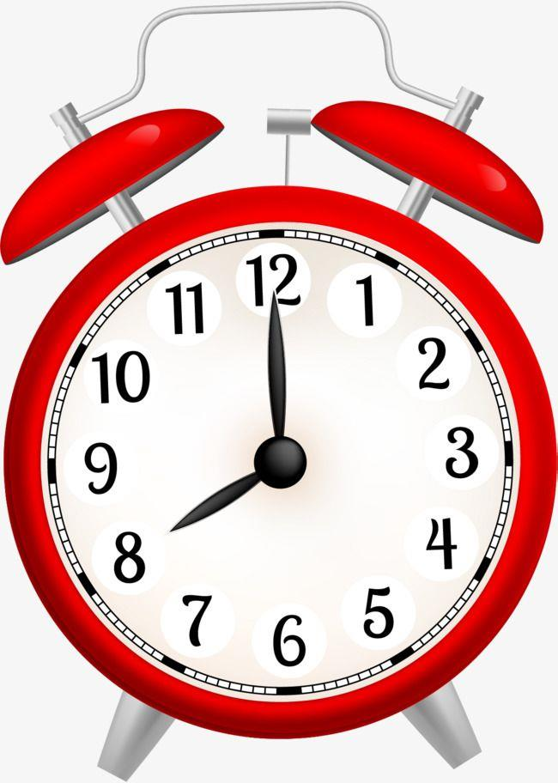
What’s the time?

Slide 18
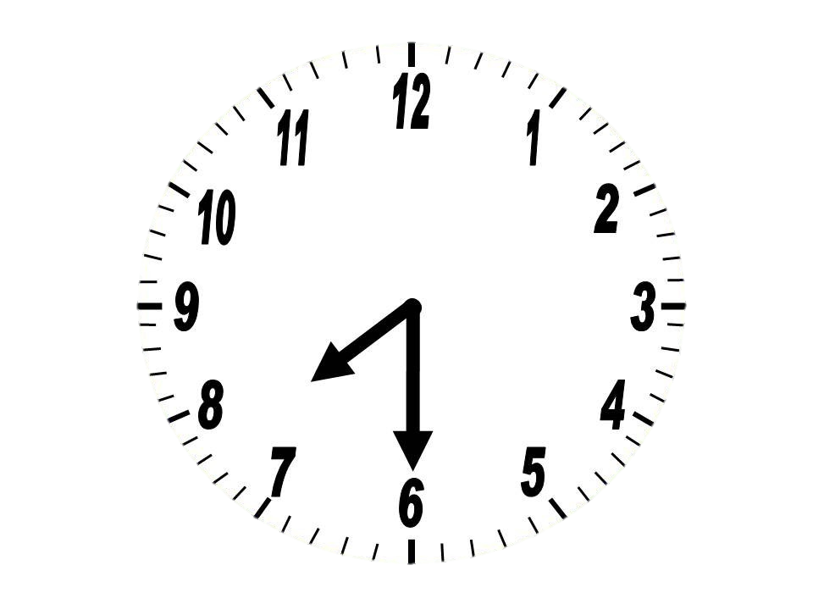
half past
seven

Slide 19
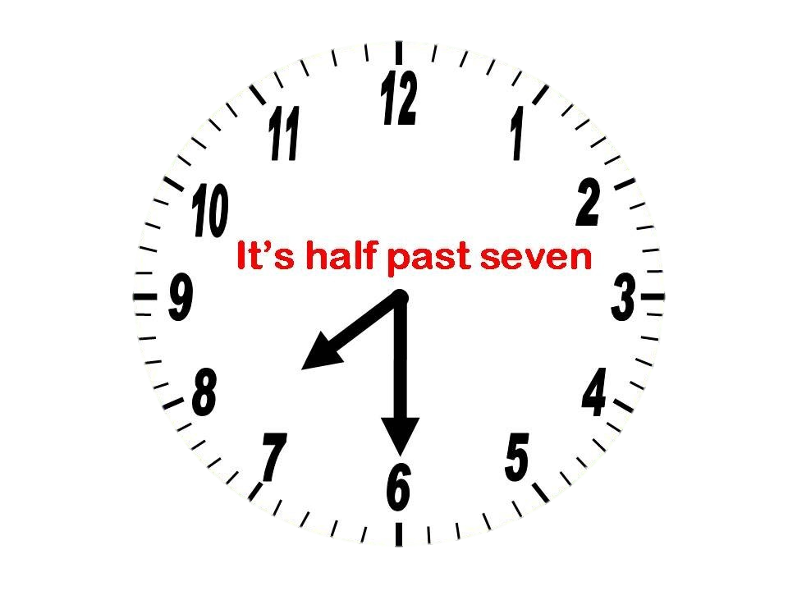

Slide 20
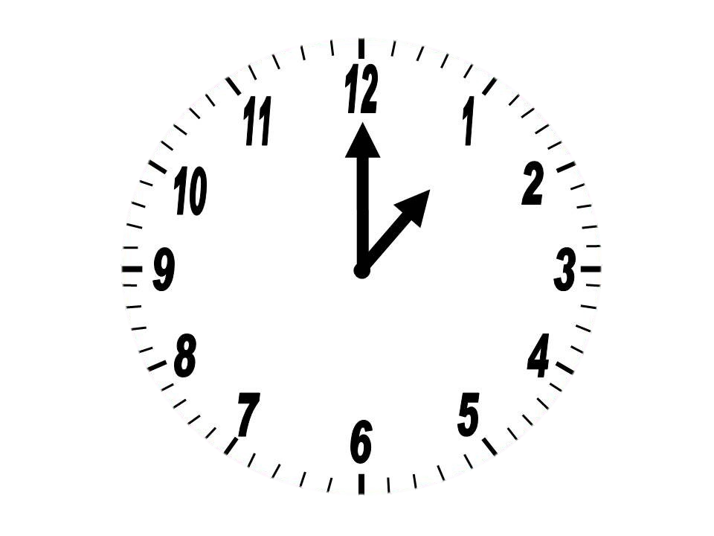
one
o’clock

Slide 21
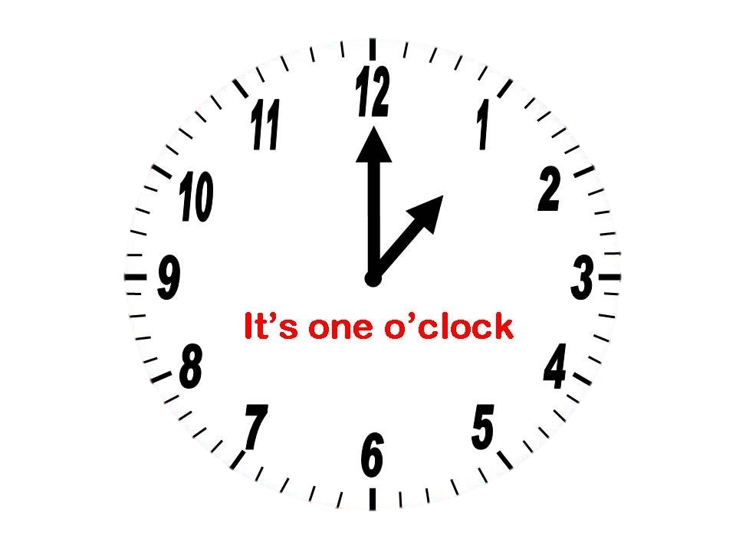

Slide 22
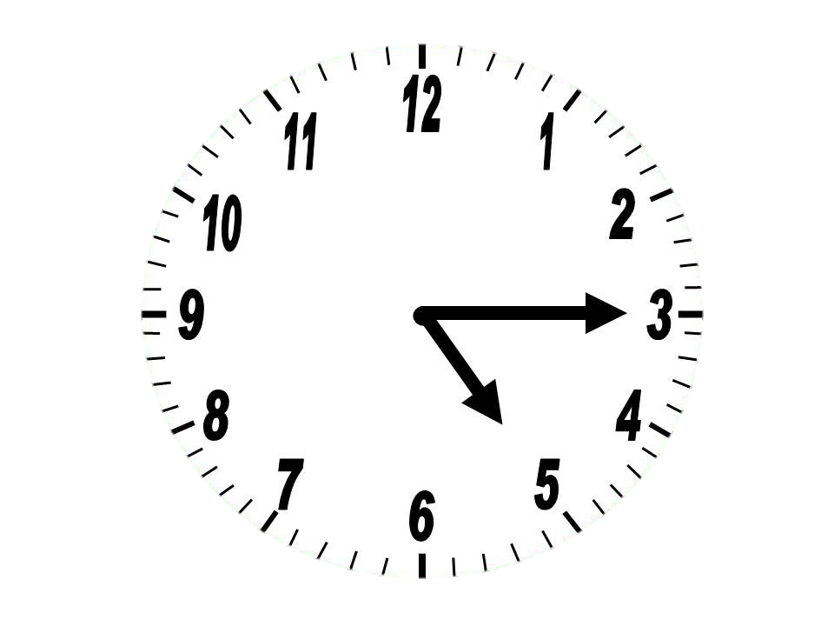
a quarter past
five

Slide 23
It’s a quarter past five

Slide 24
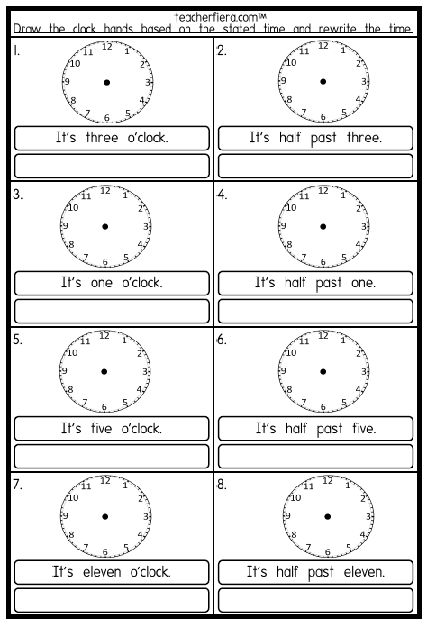
HOMEWORK 1
Print
Use English 1
Upload and ‘Turn in’.

Slide 25
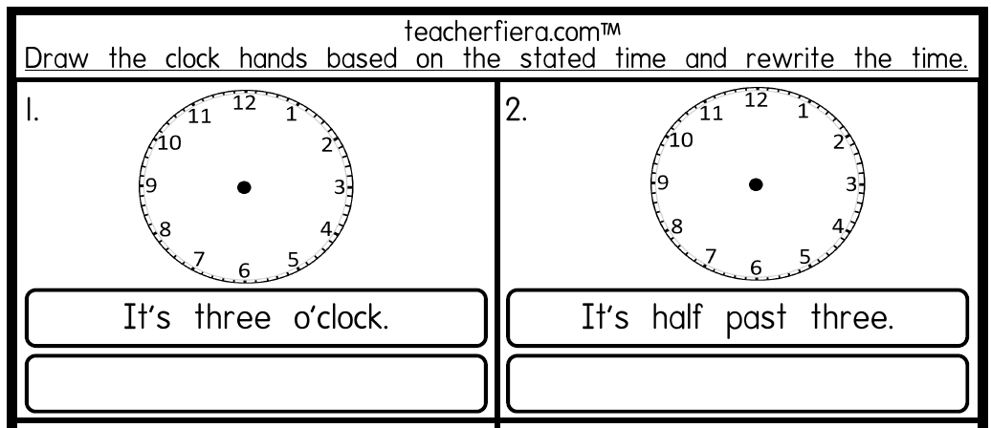
It’s three o’clock.
It’s half past three.

Slide 26
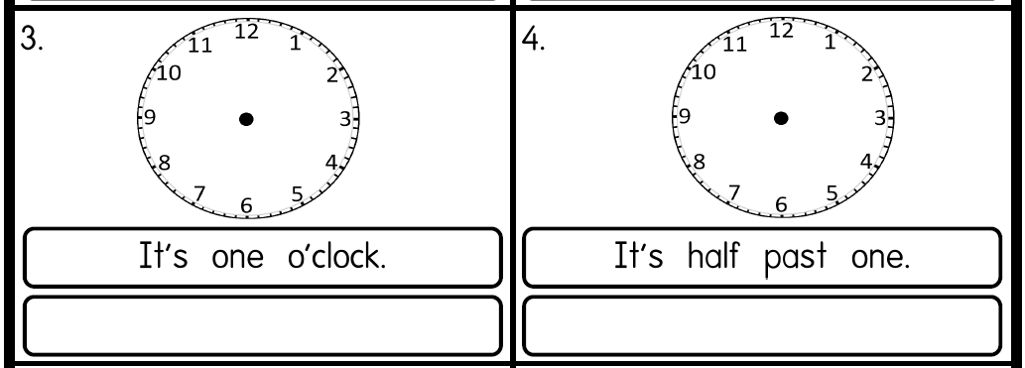
It’s one o’clock.
It’s half past one.

Slide 27
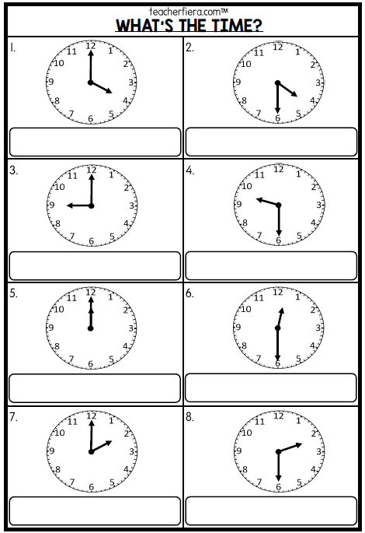
HOMEWORK 2
Print
Use English 1
Upload and ‘Turn in’.

Slide 28
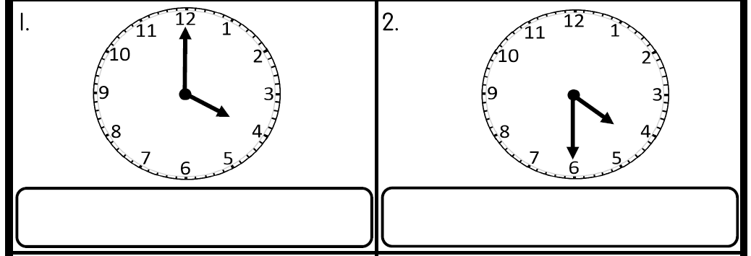
It’s four o’clock.
It’s half past four.

Slide 29


Slide 30


